Slide 1
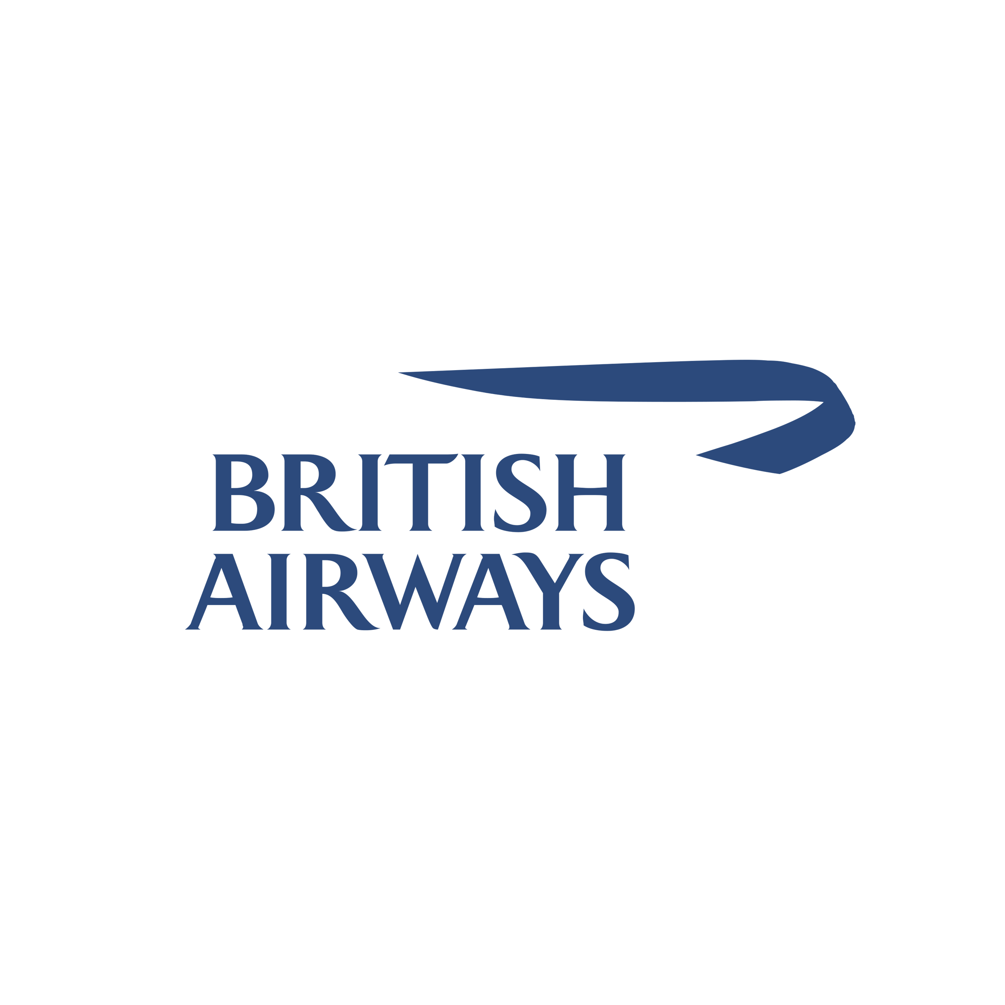
BRITISH AIRWAYS SKYTRAX REVIEW SITE WEBSCRAPING FOR BUSINESS INTELLIGENCE
NATHANAEL MUTUA – ASPIRING DATA ANALYST

Slide 2
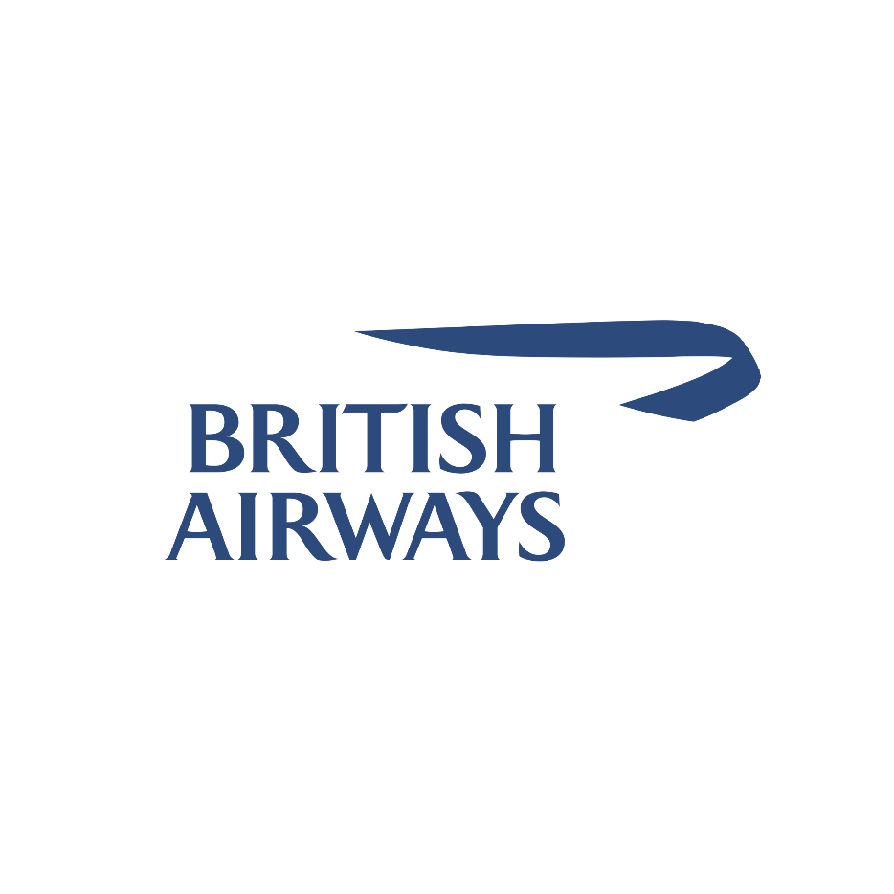
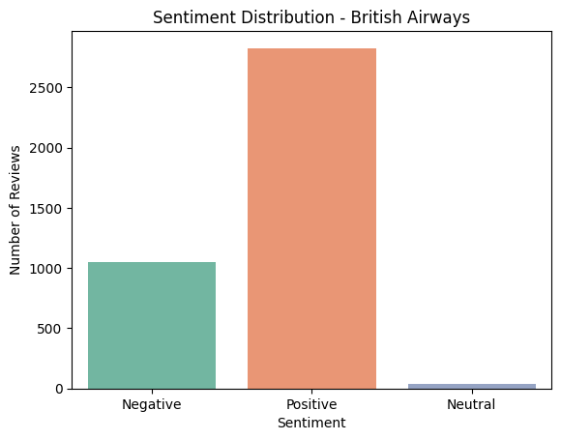
INSIGHTS BASED ON REVIEWS
Positive reviews till 25th February 2025 are 2825.
Negative reviews are 1053.
Neutral reviews are 39.
This is a general overview of customer satisfaction.
NATHANAEL MUTUA – ASPIRING DATA ANALYST

Slide 3
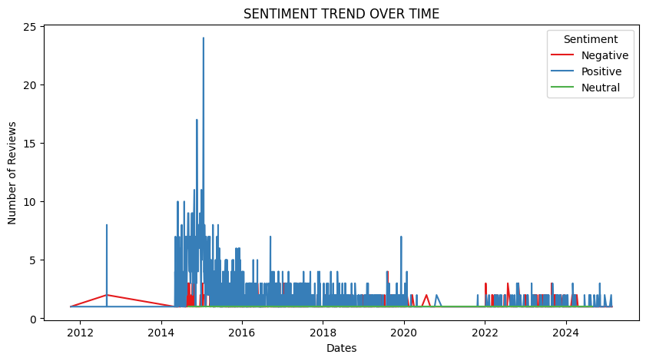
SENTIMENT TREND OVER TIME
Mid-2010s: A rise in reviews and negative sentiment between 2013–2016 may be an indication of operational issues and uncertainty leading up to the 2016 Brexit referendum.
Pandemic Effect (2020–2022): COVID-19 lockdowns and decreased flights probably mean-t fewer total reviews, and whatever remaining negative feedback did exist, usually went along with cancellations, refunds, or safety concerns.
Long-Term Sentiment Shifts: Sentiment activity declined after 2016, reflecting political and economic factors-like Brexit and pandemic lockdowns-permanently changed passenger experiences and feedback patterns.
NATHANAEL MUTUA – ASPIRING DATA ANALYST

Slide 4
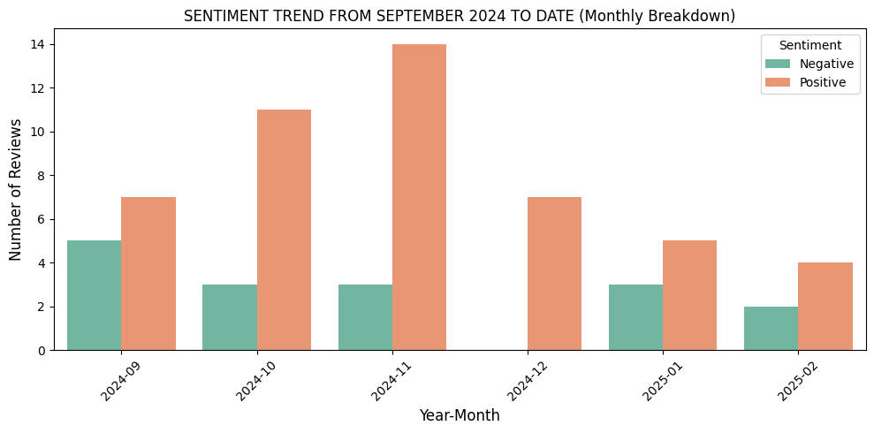
SENTIMENT TREND 2024-09 TO DATE
High Point Positive Comments: The highest positive ratings were in November 2024, indicating an effective marketing campaign, product release, or holiday. This peak indicates customers embraced offers, festive deals, or improved services.
Minor Changes in Negative Feedback: Negative reviews come out every month but peak significantly in October and December 2024. Analyzing repeat problems can address underlying causes and avert future discontent.
Total Review Decline (Jan–Feb 2025): Reviews fall off after December, likely due to post-holiday trends or scaled-back promotional activities. Lower feedback quantities might also mean less engagement; research keeping customers engaged and collecting steady feedback year-round.
NATHANAEL MUTUA – ASPIRING DATA ANALYST

Slide 5
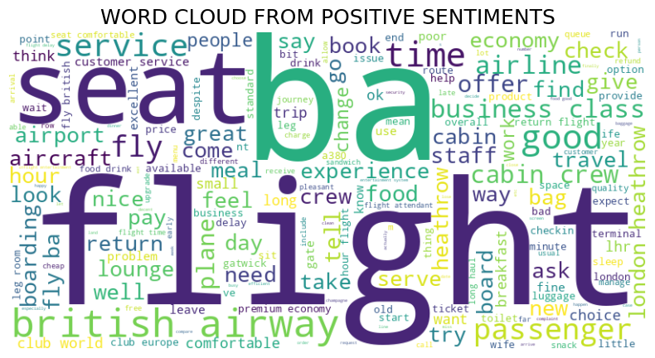
WORD CLOUD FOR POSITIVE SENTIMENTS
Comfort & Service: Constant mention of seat, cabin, crew, service, and comfort indicates that travelers highly appreciate in-flight experience and staff attentiveness.
Premium Experience & Amenities: Words like business, class, lounge, upgrade, and meal indicate that travelers appreciate improved cabin options, quality meals, and added perks.
Travel Process: Airport, check, bag, and time represent positive travel news with a focus on convenience and efficiency beyond the flight.
NATHANAEL MUTUA – ASPIRING DATA ANALYST

Slide 6
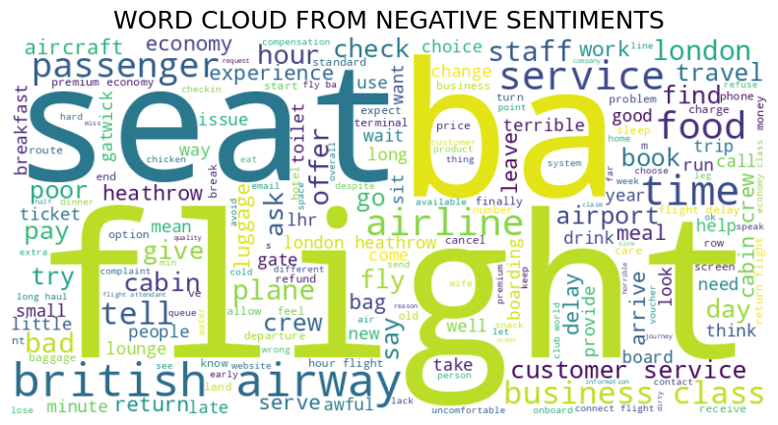
WORD CLOUD FOR NEGATIVE SENTIMENTS
Seat and Flight Problems: Seat appears prominently, indicating complaints about comfort, seat assignments, or fees. Flight indicates discontent with delays, cancellations, or rebooking.
Staff and Service Problems: Terms such as service, crew, and customer suggest complaint regarding staff attitude and service quality.
Logistics & Extra Costs: Baggage handling issues, lengthy delays, and cancellations of flights are indicated by mentions of bag, time, hour, and cancellation. Refund, price, and offer indicate annoyances with hidden fees, surprise charges, or poor compensation practices.
NATHANAEL MUTUA – ASPIRING DATA ANALYST

Slide 7
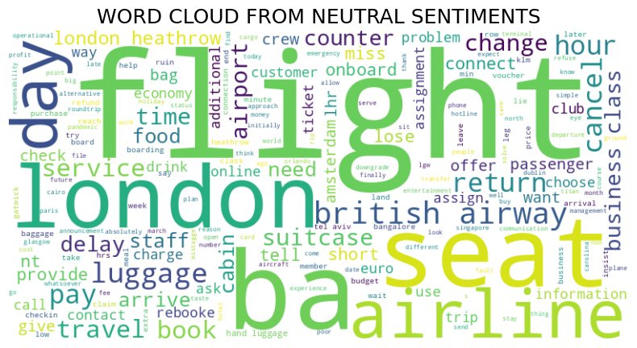
WORD CLOUD FOR NEUTRAL SENTIMENTS
Highlight Travel Logistics: Mentions of flight, seat, airline, and luggage indicate that neutral comments do involve basic travel mechanics (i.e., booking, seating, baggage) as opposed to extreme praise or complaints.
Site and Timing: London, day, and hour are some of the words that reflect tourists discussing flight duration, layovers, and routes, particularly with British Airways' main hub in London (e.g., Heathrow).
Practical Notes Terms such as return, cancel, ticket, and suitcase speak in a matter-of-fact manner of travel flight plan modifications and baggage. They emphasize the commonplace aspects of traveling without any worked-up emotions.
NATHANAEL MUTUA – ASPIRING DATA ANALYST

